Slide 1
Why so Fragile?
Steve Rabin
GDC AI Summit 2013

Slide 2
In general, is Game AI
Fragile or Robust?

Slide 3



Slide 4
Fragile things don’t like volatility
Fragile things want predictability

Slide 5
Human players are
unpredictable

Slide 6
Linear Gameplay
Constrained Gameplay
“Rails”

Slide 7
Open-ended
sandbox games

Slide 8

What is the opposite
of fragile?

Slide 9

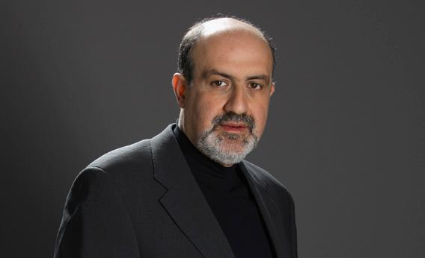

Slide 10
During development
we are Antifragile

Slide 11
After the game
is released?

Slide 12
PATCH

Slide 13
Why is being Antifragile so
difficult to program into AI?

Slide 14


Slide 15
Black Swan Event
Outlier
Extreme Impact
Retrospectively Predictable

Slide 16
Black swan events can’t be predicted

Slide 17
Questions
How do you survive randomness?
How do you survive volatility?
How do you survive Black Swan events?

Slide 18
Antifragile

Slide 19
Muscles are Antifragile

Slide 20
Human Opponents are Antifragile

Slide 21
Fragile
Procedural
Architectures
State
Machines
Robust
Declarative
Architectures
Planning
Goal-Based
Antifragile
Adaptive
Architectures
Player
Modeling

Slide 22

Changing Design Philosophy
From:
  Designing a system according to specified performance requirements
To:
  Systems that evolve, adapt, and optimize in real-time to adapt functionality and performance to meet the unknown
Morphing Wing, Learn to Fly, Autonomy, Swarming, System Health Management, Self-Healing Materials

Slide 23
“If you are Antifragile,
it means you are alive”
-Nassim Taleb

Slide 24
Avoid being Fragile
Deliver Robustness
Aspire to be Antifragile

